Slide 1

Descriptive statistics. Quantitative variables
Lect. Dr. Tudor Călinici
Notes:
NOTE:
To change the image on this slide, select the picture and delete it. Then click the Pictures icon in the placeholder to insert your own image.

Slide 2
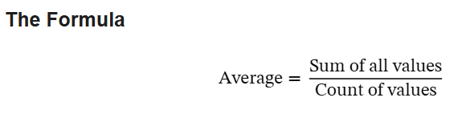
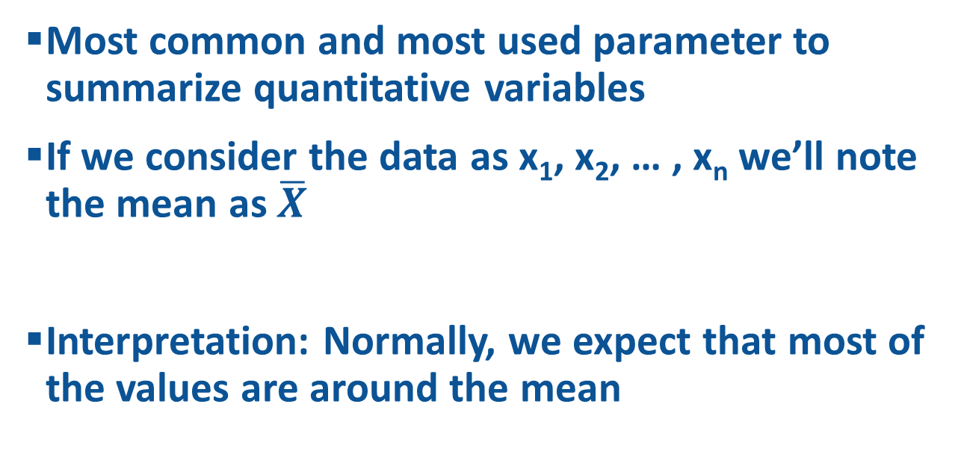
Average – Arithmetical mean - Mean
Most common and most used parameter to summarize quantitative variables
If we consider the data as x₁, x₂, … , x_{n} we’ll note the mean as $\overline{X}$
Interpretation: Normally, we expect that most of the values are around the mean

Slide 3
Answer – Age – Quantitative variable
Mean = 20
Interpretation: Normally, most of the people in my sample have the age around 20 years

Slide 4
Limitations
Extreme values ​​will reduce the ability to estimate of the mean.
Sometimes other parameters are more useful to report the expected

Slide 5
Central tendency parameters
Mean – Normally most of the data are around it
Median – Half of the data are less (more) than it
Mode – the most frequent value is it
For our data (Age)
  Mean = 20
  Median = 20
  Mode = 19

Slide 6
Spreading parameters
Minimum
Maximum
Range = (Maximum – Minimum)
For our data (Age)
  Minimum=17
  Maximum = 27
  Range = 10

Slide 7
Example: Age
  Minimum=17
  Maximum = 27
  Range = 10
  Mean = 20
  Median = 20
  Mode = 19
In this sample, normally, most of the students are around 20. Half of the students are more than 20 years old. The youngest students are 17-year-old and the oldest is 27-year-old (10 years difference). The most frequent age is 19.

Slide 8
Example – Age(years)
Sample 1:
18 19 20 21 23 24 25 26 27 28
Min=18;Max=28, Median 23,5; Mean: 23,1
Sample 2:
18 18 18 19 20 27 27 28 28 28
Min=18;Max=28, Median 23,5; Mean: 23,1
Sample 3:
18 20 23 23 23 24 24 24 24 28
Min=18;Max=28, Median 23,5; Mean: 23,1

Slide 9

The Variance
Presents the dispersion of the data around the mean
For the data:10, 20, 20, 30, 30, 40; Mean = 25
Variance = [(20-25)² +(10-25)²+(30-25)²+
+40-25)²+(30-25)²+(20-25)²]/6 = 550/6=91.66

Slide 10

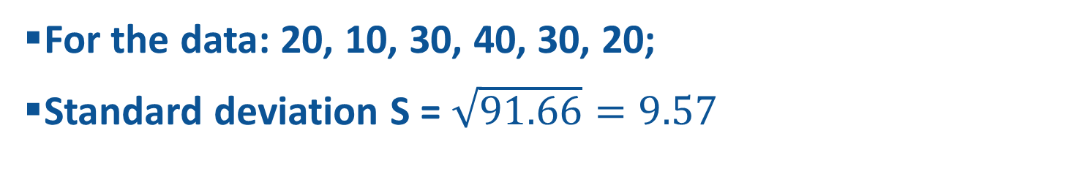
Standard deviation
For the data: 20, 10, 30, 40, 30, 20;
Standard deviation S = $\sqrt{91.66}=9.57$

Slide 11
Answer - Age
Variance = S²=3.47
Standard deviation S=1.86
Normally, most of the students in the sample have the age in the interval [20-1.86 , 20+1.86] - [18.14 , 21.86] - years

Slide 12
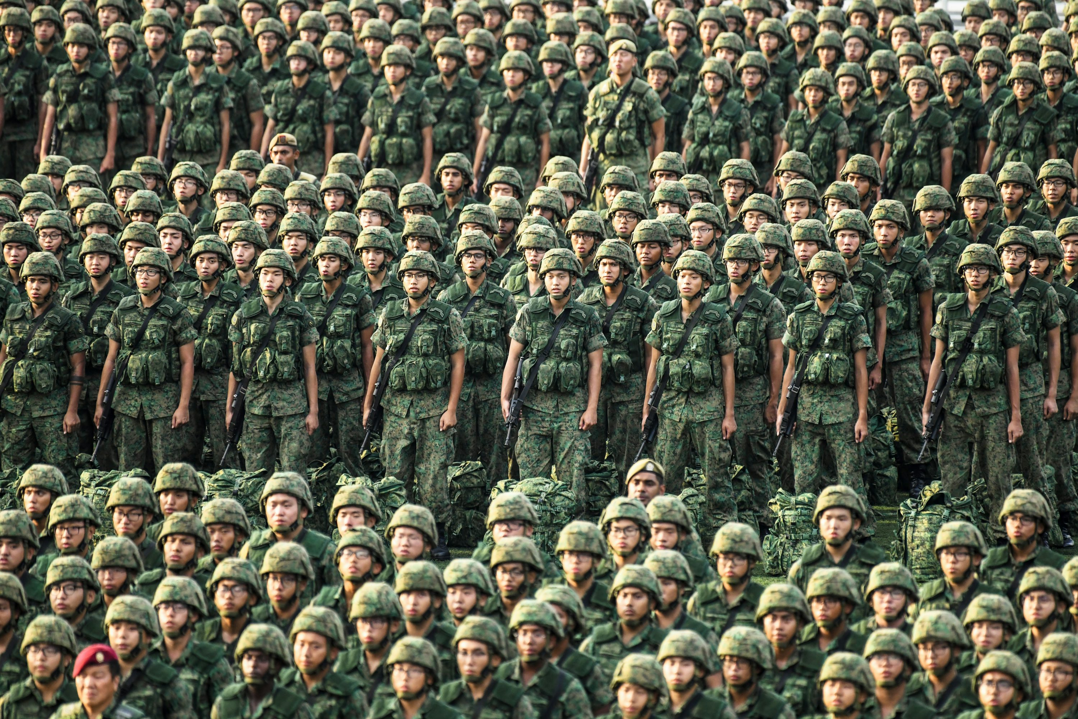
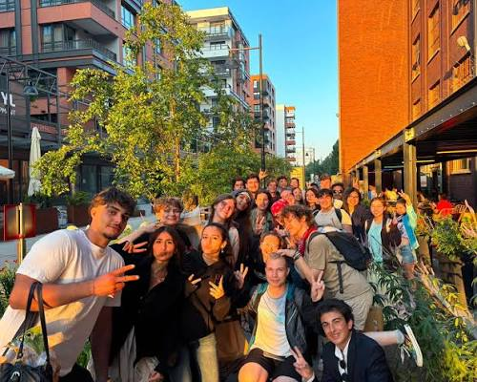
Homogeneity
Homogeneous group
Heterogeneous group

Slide 13

The coefficient of variation
For the data: 20, 10, 30, 40, 30, 20;
Mean = 25; Standard deviation = 9.57
CV = 9.57/25 = 0.38

Slide 14
The Level of the homogeneity
If CV <10% - homogeneous data
If CV is between 10 % and 20 % -relative homogeneous data
If CV is between 20 % and 30 % - relative heterogeneous data
If CV >30% - heterogeneous data

Slide 15
Answer - Age
Mean = 20, StDev=1.86, CV = 9.3%
According to the age, the group is homogeneous

Slide 16
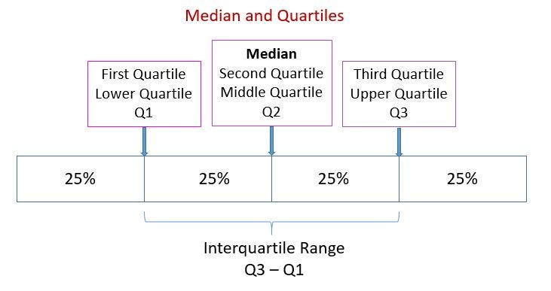
Localization
Quartiles (Q1, Q2, Q3)
Percentiles (%)

Slide 17
Answer - Age
Q1 = 19, Q2=20, Q3 = 21In this sample 25% of the students are less or equal than 19 years old, 50% of the students are at least 20 years old, 75% of the students are at least 21 years old

Slide 18
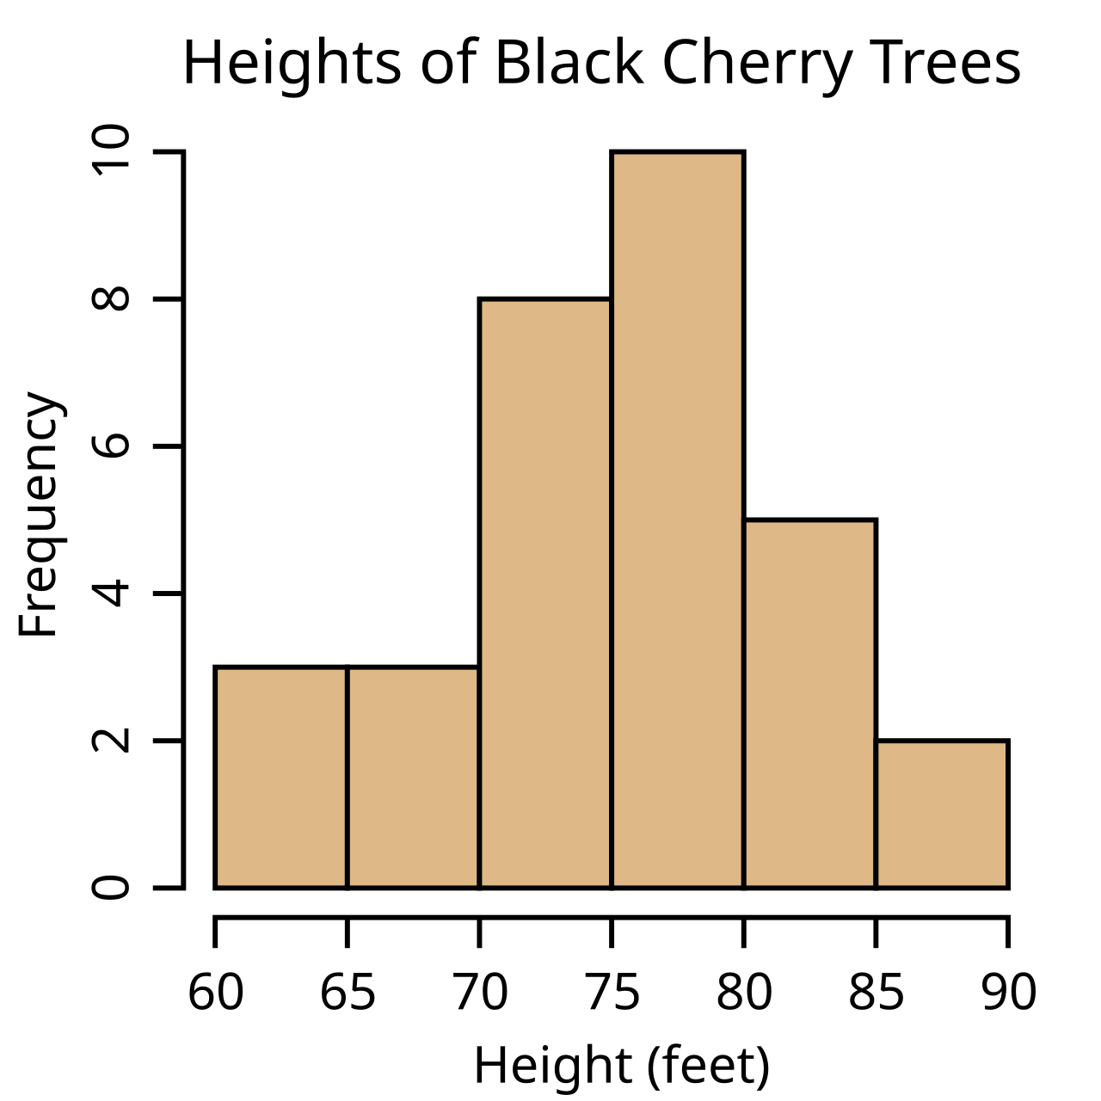
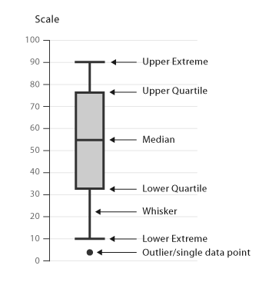
Charts – Histogram and Box and Whisker

Slide 19
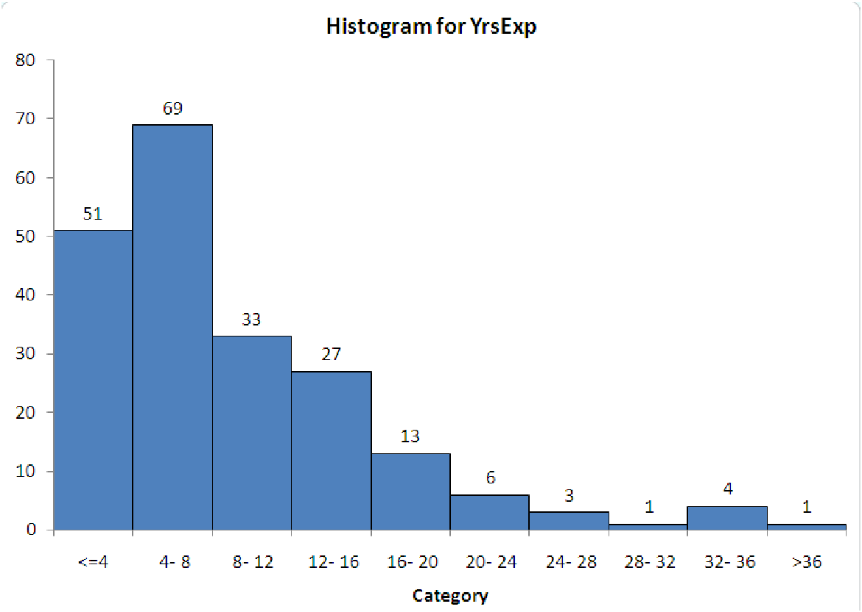
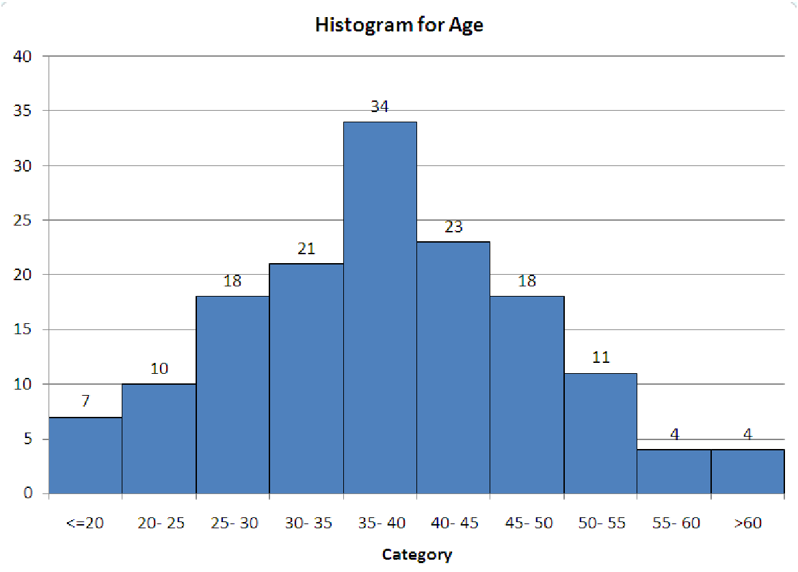
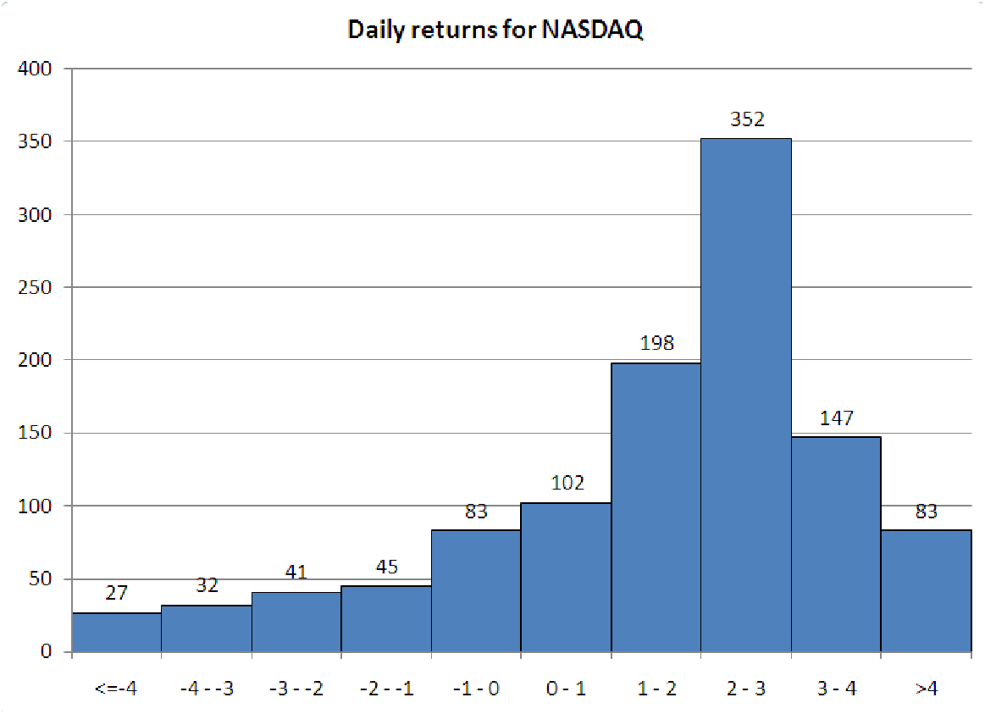
Histogram
Presents the distribution of the quantitative variable
Skew > 1
Positively (right skewed) data
Skew < -1
Symmetrical data
Skew ≈ 0
Negatively (left skewed data)

Slide 20
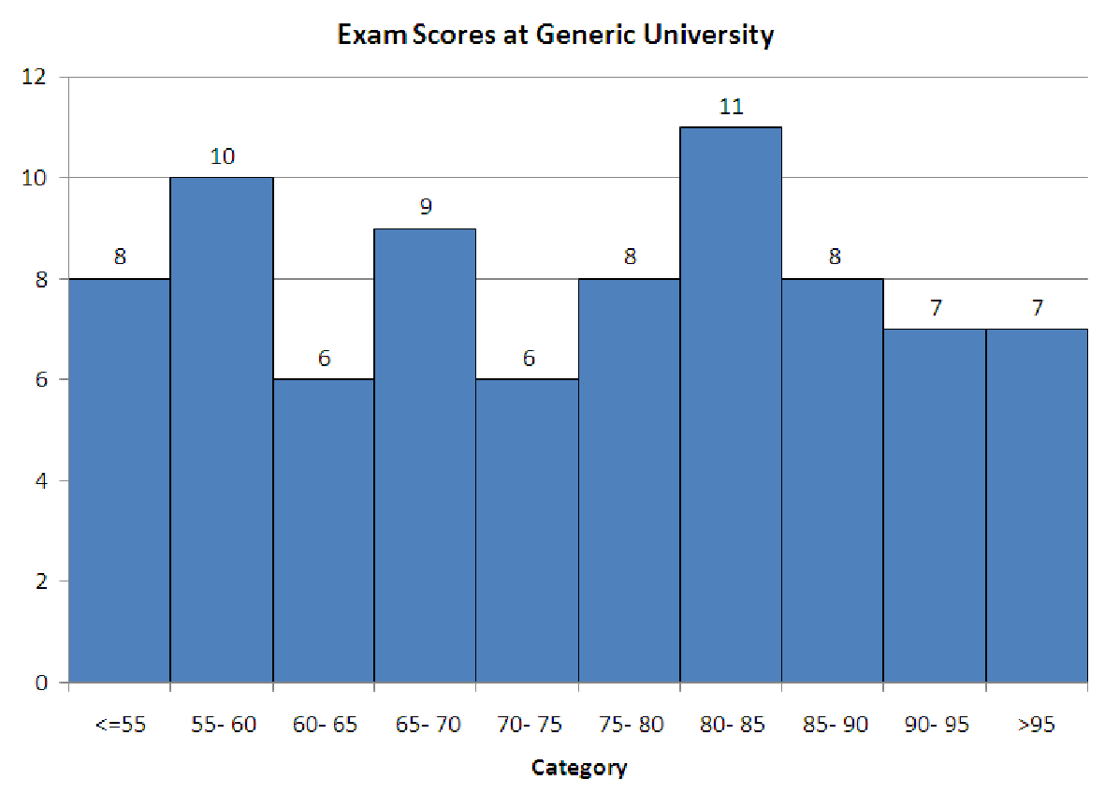
Histogram
Uniform distribution

Slide 21
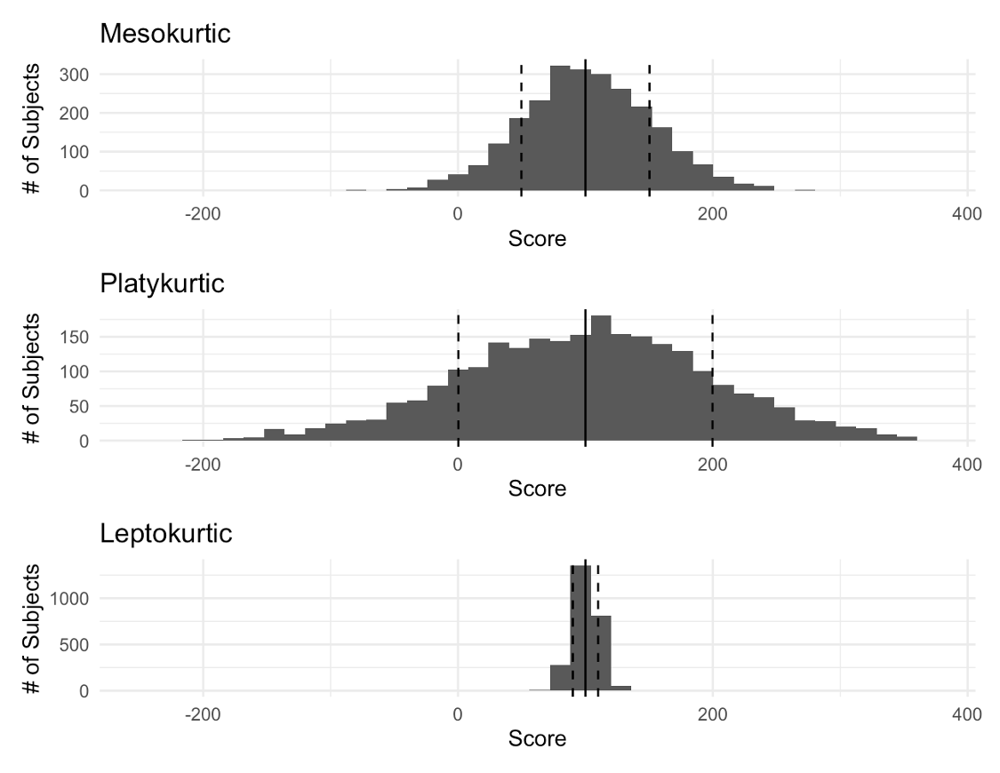
Histogram
Mesokurtic – Kurt ≈ 0
Platykurtic – Kurt >1
Leptokurtic – Kurt < -1

Slide 22
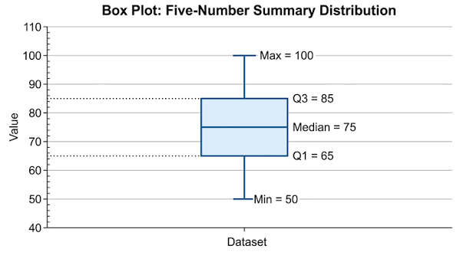
Box and Whiskers Chart
In a box-and-whisker plot, the whiskers usually extend to the most extreme data values within the following limits:
Lower limit: Q1 − 1.5 × IQR
Upper limit: Q3 + 1.5 × IQR
where IQR = Q3 − Q1.
Therefore, the length of each whisker is not necessarily 1.5 × IQR: it starts at the edge of the box and extends to the farthest observation within the corresponding limit. Values beyond these limits are plotted separately as outliers

Slide 23
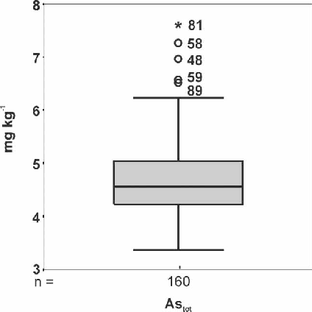
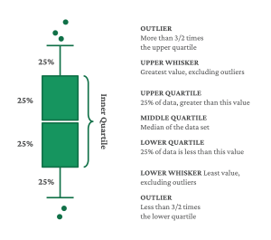
Box and whiskers – One group

Slide 24
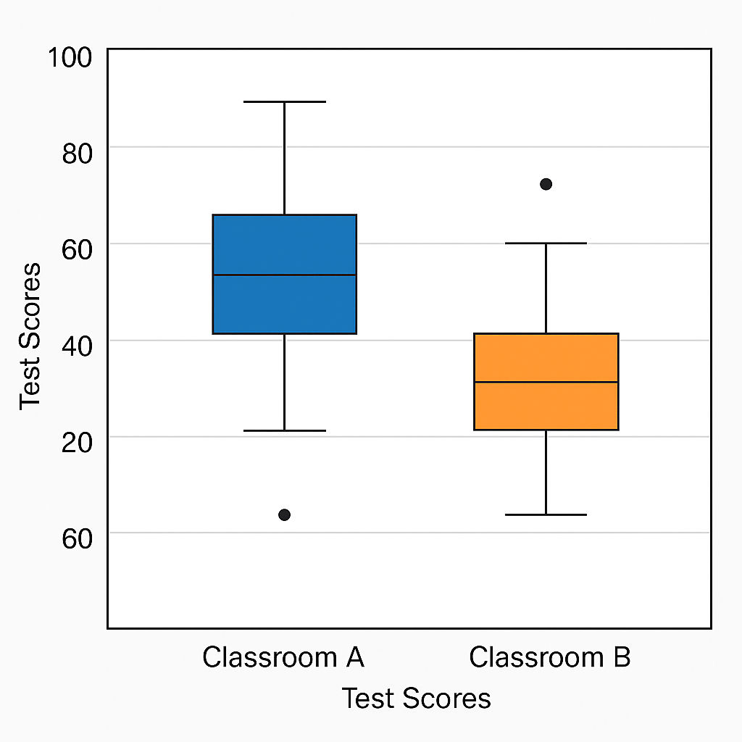
Box and Whisker - comparing groups

